Slide 1
MODEL SELECTION & IMPROVEMENT
Cross-validation is a statistical technique used in machine learning and statistics to assess the performance and generalizability of a predictive model.
The primary purpose of cross-validation is to provide a more reliable estimate of a model's performance on an independent dataset than a single train-test split.
Here are some key reasons why cross-validation is used:
Model Evaluation
Reducing Variance
Maximizing Data Utilization
Detecting Overfitting
Hyperparameter Tuning
Model Selection
Imbalanced Datasets
Real-world Performance Estimation
Cross-validation is like testing different models to find the best one in machine learning. It ensures models work well with various data parts and helps make them adaptable. Think of it as finding the right outfit for different occasions.

Slide 2
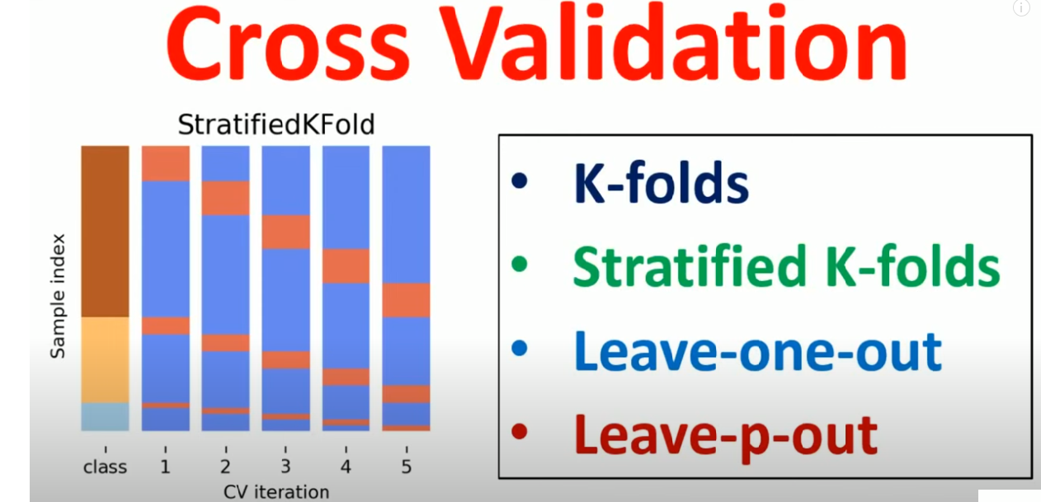
https://www.youtube.com/watch?v=PF2wLKv2lsI

Slide 3
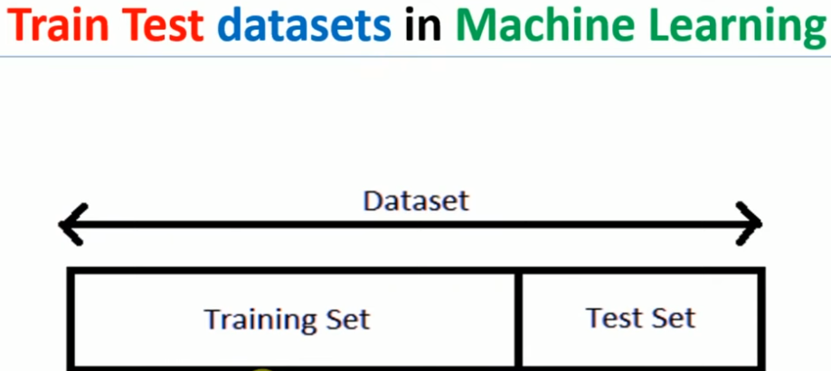

Slide 4
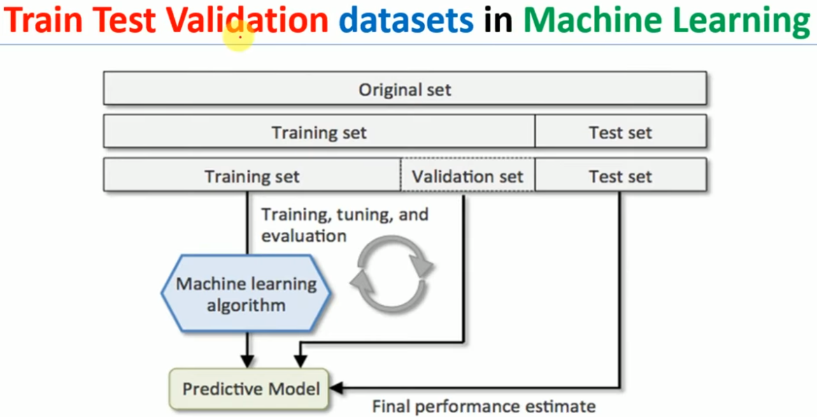

Slide 5
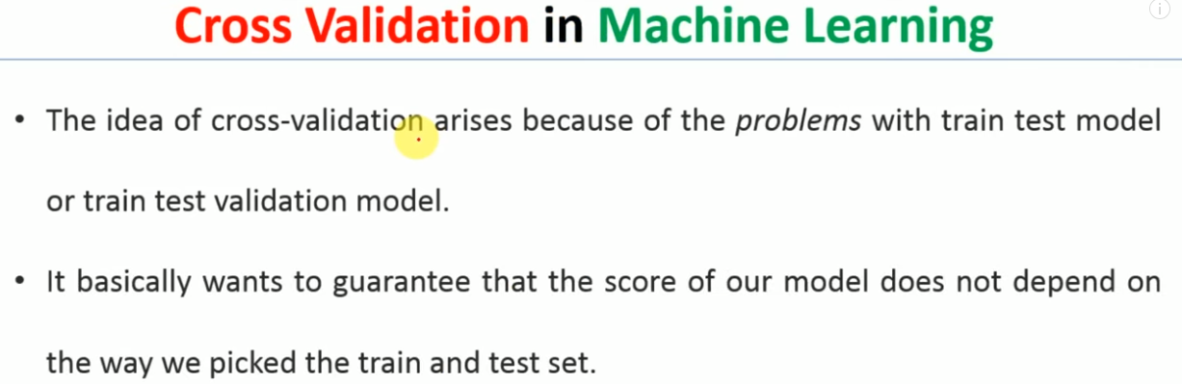

Slide 6
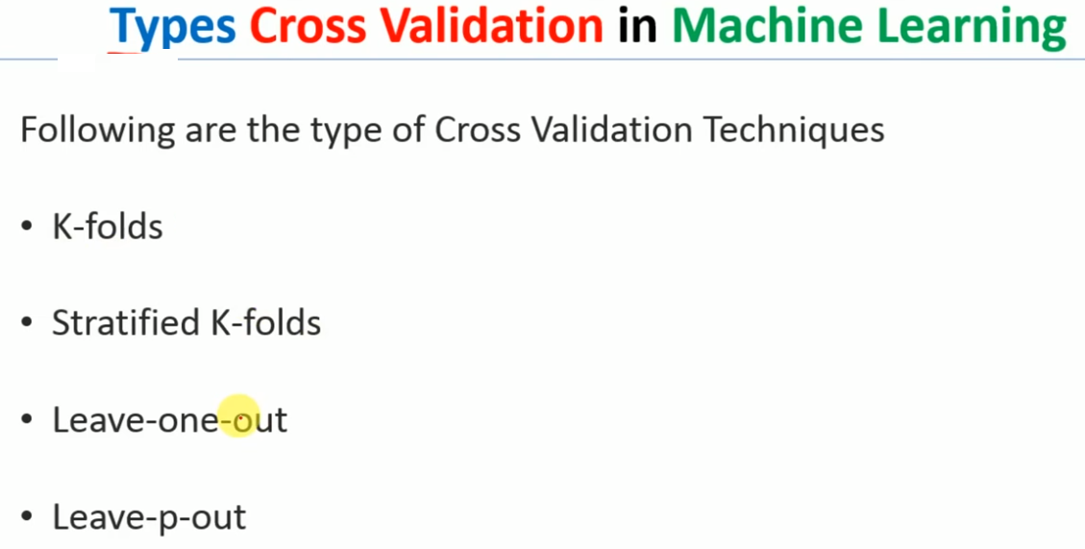

Slide 7
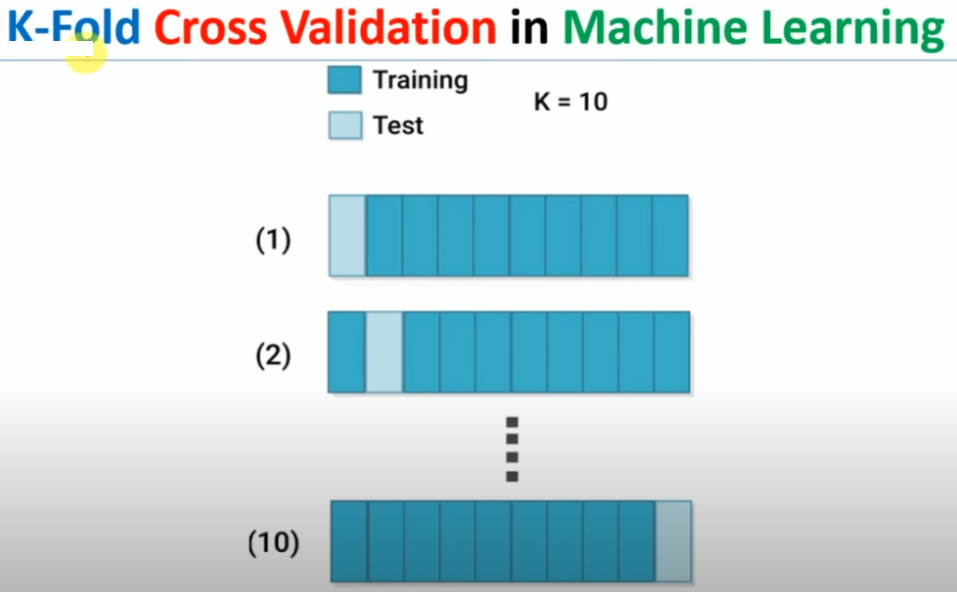

Slide 8
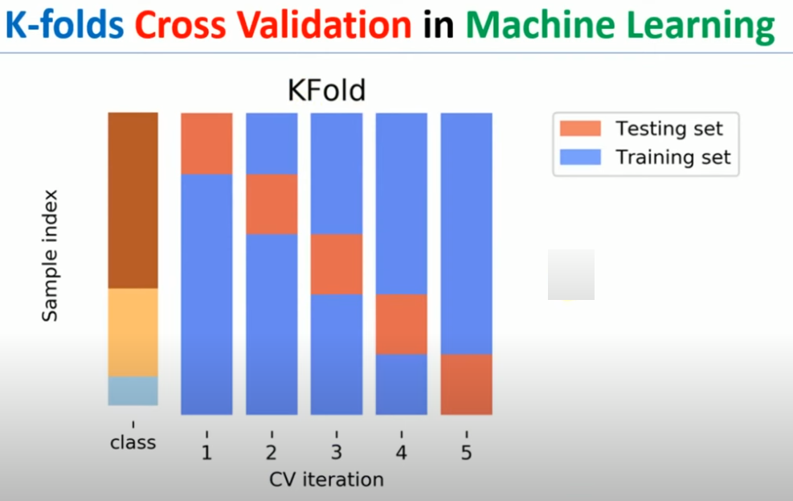

Slide 9
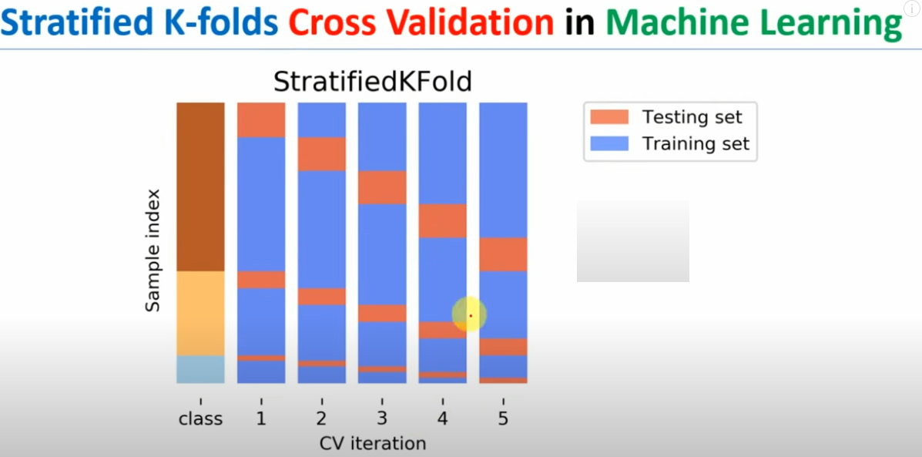

Slide 10
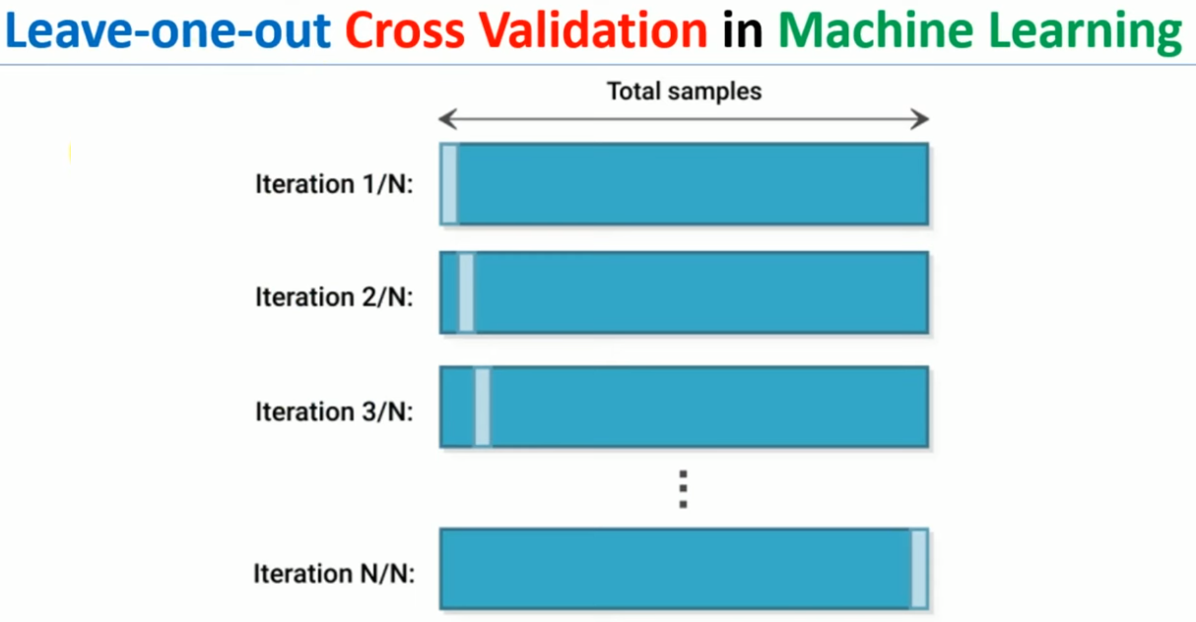

Slide 11
